Slide 1
SWE2301:Introduction to software engineering
Lecture 04: Software Design
Venue: CIT Theater
Time: 10-1pm
Presented by M. I. Mukhtar

Slide 2
Lecture Outline
Software Design
  Context Models
  Architectural Design
  Design Models

Slide 3
Design and implementation
Software design is a creative activity in which you identify software components and their relationships, based on a customer’s requirements.
Software design and implementation activities are invariably inter-leaved.

Slide 4
Build or buy
In a wide range of domains, it is now possible to buy off-the-shelf systems (COTS) that can be adapted and tailored to the users’ requirements.
  For example, if you want to implement a medical records system, you can buy a package that is already used in hospitals. It can be cheaper and faster to use this approach rather than developing a system in a conventional programming language.
When you develop an application in this way, the design process becomes concerned with how to use the configuration features of that system to deliver the system requirements.

Slide 5
An object-oriented design process
Structured object-oriented design processes involve developing a number of different system models.
They require a lot of effort for development and maintenance of these models and, for small systems, this may not be cost-effective.
However, for large systems developed by different groups design models are an important communication mechanism.
Notes:
The level of detail in the design depends on the type of system and whether you are using a plan-driven or agile approach.

Slide 6
Process stages
There are a variety of different object-oriented design processes that depend on the organization using the process.
Common activities in these processes include:
  1. Define the context and interaction of the system;
  2. Design the system architecture;
  3. Develop design models;

Slide 7
1. System context and interactions
Understanding the relationships between the software that is being designed and its external environment is essential for:
  deciding how to provide the required system functionality
  how to structure the system to communicate with its environment.
  how to establish the boundaries of the system.
Notes:
Setting the system boundaries helps you decide what features are implemented in the system being designed and what features are in other associated systems.

Slide 8
Context and Interaction models
A system context model is a structural model that demonstrates the other systems in the environment of the system being developed…Context Diagram.
An interaction model is a dynamic model that shows how the system interacts with its environment as it is used… Use Case Diagram.

Slide 9
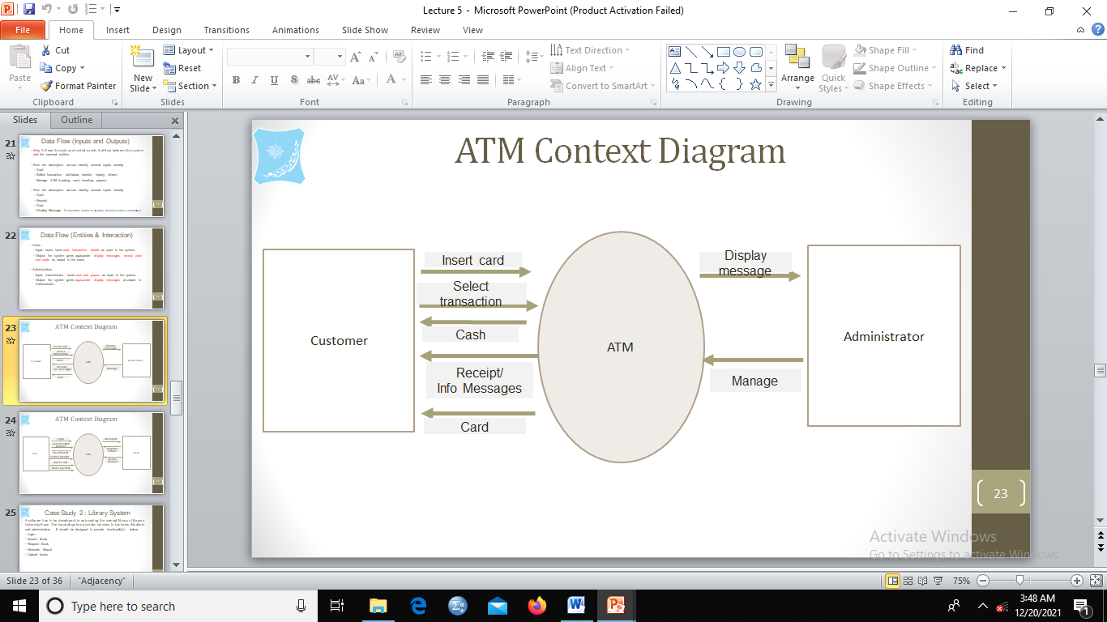
Context Diagram of ATM

Slide 10
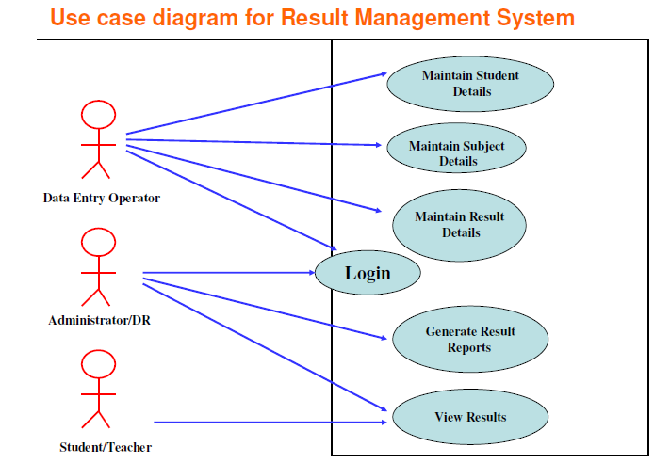

Slide 11
2. Architectural design
Once interactions between the system and its environment have been understood, this information is used for designing the system architecture.
The major components that make up the system and their interactions are identified, and then organized using an architectural style such as a layered or client-server model.
An architectural style (pattern) is a stylized description of good design practice, which has been tried and tested in different environments (Software).

Slide 12
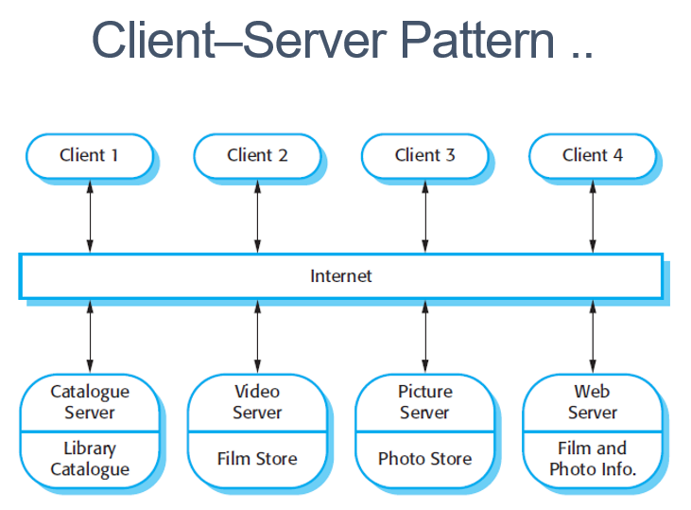
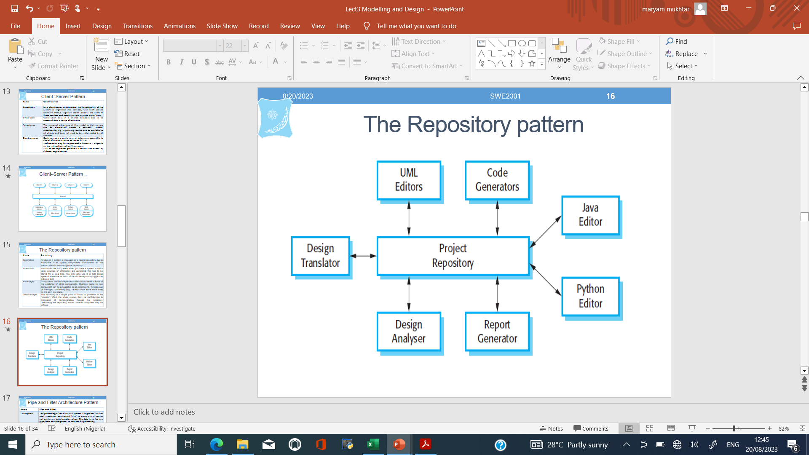
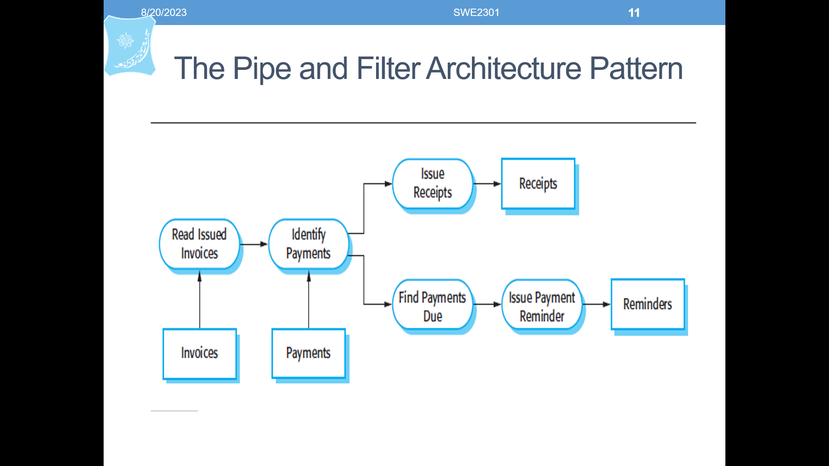
Examples of Architectural Styles..

Slide 13
3. Design models
Design models show the objects and object classes and relationships between these entities.
Static models describe the static structure of the system in terms of object classes and relationships.
Dynamic models describe the dynamic interactions between objects.

Slide 14
Examples of Design Models
Subsystem models that show logical groupings of objects into coherent subsystems.
Sequence models that show the sequence of object interactions.
State machine models that show how individual objects change their state in response to events.
Other models include use-case models, aggregation models, generalisation models, etc.

Slide 15
Subsystem models
Shows how the design is organised into logically related groups of objects.
In the UML, these are shown using packages - an encapsulation construct. This is a logical model. The actual organisation of objects in the system may be different.

Slide 16
Sequence models
Sequence models show the sequence of object interactions that take place
  Objects are arranged horizontally across the top;
  Time is represented vertically so models are read top to bottom;
  Interactions are represented by labelled arrows, Different styles of arrow represent different types of interaction;

Slide 17
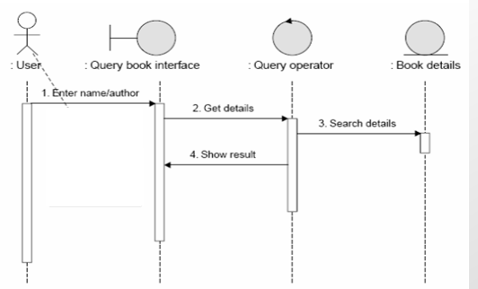
Sequence diagram of Querying a book

Slide 18
State Diagrams
State diagrams are used to show how objects respond to different service requests and the state transitions triggered by these requests.
State diagrams are useful high-level models of a system or an object’s run-time behavior.
  You do not usually need a state diagram for all of the objects in the system.
Notes:
Many of the objects in a system are relatively simple and a state model adds unnecessary detail to the design.

Slide 19
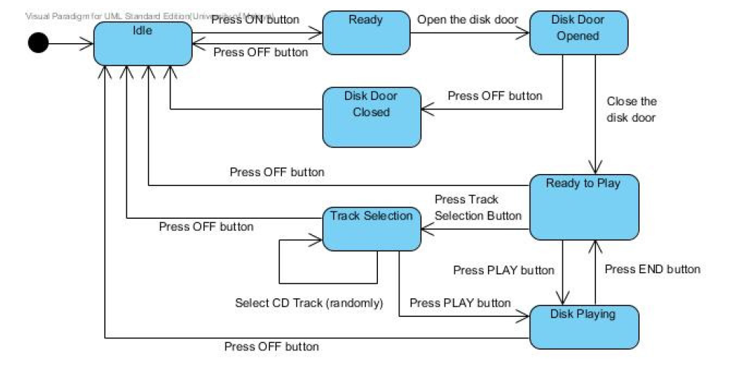
State diagram of a CD Player

Slide 20
Summary
Software design and implementation are inter-leaved activities.
The process of object-oriented design includes activities to identify context of system, design the system architecture and describe the design using different object models.
A range of different models may be produced during an object-oriented design process.
  These include static models (class models, generalization models, association models) and dynamic models (sequence models, state machine models).

Slide 21
Question ??

